Slide 1

Python data analytics
for mear mortals

Slide 2
Objectives
Learn the difference between data “science” and “analysis”, and understand the characteristics (and toolsets) of their practitioners.
Learn how to use Python (with a few 3rd party modules) to modernize your data transformation, analysis, and visualization tasks
Learn how to integrate these new tools and techniques into your everyday business workflows and applications

Slide 3

Who This is for
Primary Audience
Application developers
Data/Business analysts *
Excel masters *
Anyone interested in
Simple data analysis
Static & Dynamic reporting
Excel automation
Integration with other apps/tools
* some coding experience required

Slide 4
Data Science
An interdisciplinary field about processes and systems used to extract knowledge or insights from data in various forms, either structured or unstructured
Data Analytics
The science of examining raw data with the purpose of drawing conclusions about that information.

Slide 5


Different Practices
Patterns, correlations, models
Output
Reports, KPIs, trends
Exploratory, experimental
Process
Static, comparative
On the fly, as-needed
Sources
Planned, added slowly
“Good enough”, probability
Quality
Single version of truth
Predictive, prescriptive
Analysis
Retrospective, descriptive
Data Science
Data Analytics

Slide 6
Different practitioners
I feel comfortable operating
with incomplete data
I want to have a
complete set of data
My data files
are often messy
My data files
are usually clean
I explore data to see
what it tells me
I report on what
the data says
My dataset is so big, managing
it is part of the problem
My dataset can get big,
but it’s currently manageable
My findings help
predict the future
My findings help
measure the past
Data Scientists
Data Analysts

Slide 7
Different Tools
Hadoop, Java, Python,
SQL, NoSQL, Excel, etc.
Capture
Excel, VBA, SQL, etc.
R, Python, Excel, SAS, etc…
Analyze
Excel, VBA, SQL, etc.
R, Flare, HighCharts,
AmCharts, D3.js,
Bokeh, Excel, etc.
Present
Excel, Business objects, etc.
Data Science
Data Analytics

Slide 8
With that said
There is commonality, but huge differences…
Both leverage scripting languages, but usually for different purposes
Both source from SQL databases and flat files, but at very different scale
Both use Excel all over the place, but only one is reliant on it
So today, our focus is on simple analytics only…
Automating our complicated Excel tasks
Simplifying analysis tasks and report generation
Creating sophisticated visualizations
Integrating with other applications/tools
With the goal of taking our current skill sets…

Slide 9
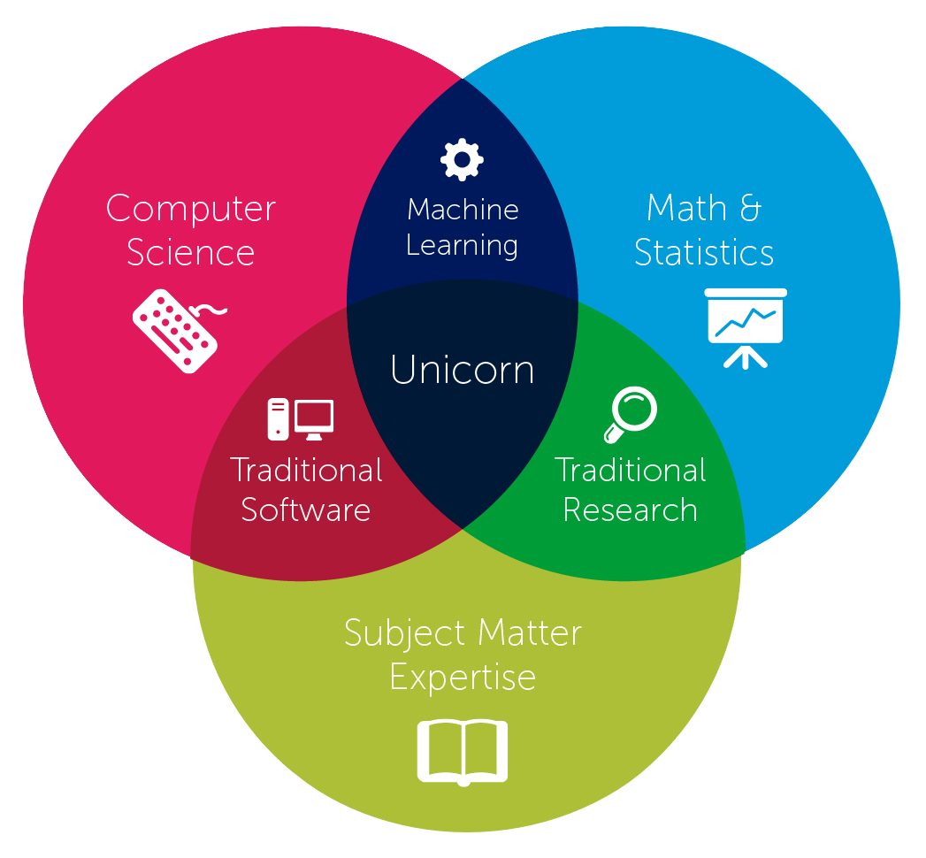
from here…

Slide 10
… to here

Slide 11
The tools we will use
NumPy - the fundamental package for scientific computing with Python
Pandas - library providing high-performance, easy-to-use data structures and data analysis tools for Python
ipython/jupyter - a web application that allows you to interactively create and share documents that contain live code, equations, visualizations and explanatory text
Bokeh - interactive visualization library for Python that targets modern web browsers for presentation
FuzzyWuzzy - fuzzy string matching in Python like a boss

Slide 12
Why Python?
Easy enough for almost anyone to learn
Painless to install - one click in Developer xChange
Flexible enough to use for almost anything
Powerful enough to build robust apps
Adaptable enough to run on any platform

Slide 13
scenario
We need to perform some basic analysis against a set of sales data with the following requirements:
The data comes to us in several parts that we need to combine prior to analysis, and the format of each part is a little different.
Next, we need to add a calculated column to the end of the combined data set. While we are at it, clean up any data quality issues.
We then need to join the results to a different set of data that contains a common key - similar to a table join in SQL.
Finally, we must join to yet another source of data based on rough string matching and quantify our match strength - like a super complex vlookup on steroids.

Slide 14
OUTPUT
Once we have completed all the tasks on the prior slide we will need to produce various forms of output :
A simple spreadsheet with all rows and columns from our result set
Another spreadsheet pre-pivoted by a set of columns, including simple aggregates
A third spreadsheet that has a different cross-section of the pivot above on each tab
An interactive chart that can be integrated into… whatever

Slide 15
Our Constraints
30 minutes to complete all tasks
Must be repeatable

Slide 16
READY.
SET.
DEMO!

Slide 17
Recap
There is a big difference between data “science” and “analysis”, make sure you use the correct term in the correct context
Nothing is wrong with Excel, but we can do many of the advanced Excel-ish stuff WAY faster and more repeatably in Python w/ Pandas
VBA is great for MS Office automation, but it isn’t as full featured as Python and you can’t build “real” apps with it
Everyone likes interactive charts, give the people what they want ;-)

Slide 18
References
http://www.forbes.com/sites/piyankajain/2013/02/25/data-science-or-analytics/
http://www.edureka.co/blog/core-data-scientist-skills/
http://pbpython.com
http://www.marketingdistillery.com/
http://pandas.pydata.org
http://bokeh.pydata.org/en/latest
https://www.continuum.io/why-anaconda
https://s3.amazonaws.com/quandl-static-content/Documents/Quandl+-+Pandas,+SciPy,+NumPy+Cheat+Sheet.pdf

Slide 19
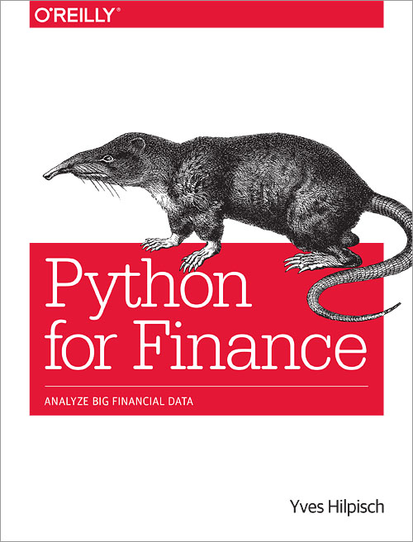
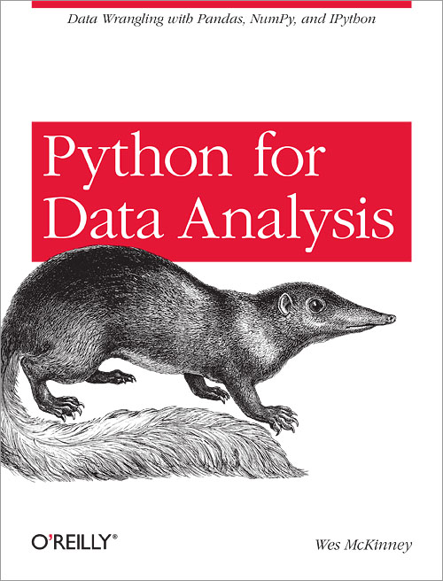
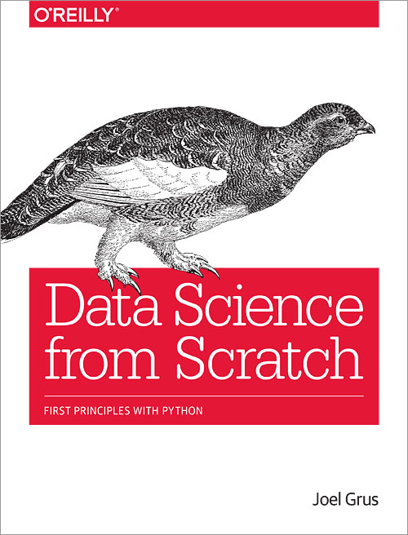
More References

